Slide 1
Hate Speech Filtering Web Extension
Yulong Cui 190198653
Arkaitz Zubiaga

Slide 2
Background
‘Racism’ is one of the many expressions of our evolved capacity to live and work in groups.
Prejudice based on race, skin colour, gender and sexual orientation.
Most common form of racism is textual based.
Euro 2020 Final - three England players targeted on social media.
More than 2000 racist tweets/posts deleted
More than 200+ social media accounts investigated
Poor mental and physical health related to racism.

Slide 3
Project Aims
Minimise user’s exposure to online racism
Reduce reliance on big social media companies to filter out harmful content
User protecting themselves from hate speech, be proactive rather than reactive

Slide 4
Project Objectives
Text
Fetch textual content from websites, store locally as text files using BeautifulSoup
Algorithm
Create a Machine Learning algorithm that performs analysis on text files using Python NLTK and Python Profanity library
Extension
Create a user-friendly web extension using JavaScript, Django, and HTML
Integration
Integrate ML algorithm with the web extension

Slide 5
Computing/Engineering problem
Filtering textual based content requires:
Natural Language Processing (NLP)
Variations of words
Combinations of phrases
Understanding in context
Machine Learning algorithm
Pattern recognizing
‘Training data’ oriented

Slide 6
Literature Review Findings
Python & related libraries
Machine Learning
Existing systems

Slide 7
Python & related libraries
Python programming language
Object-oriented
Dynamic typing, binding
Extensive selection of Machine Learning libraries
Natural Language Processing (NLTK libraries)
Text processing libraries:
Classification
Tokenization
Stemming
Tagging
Parsing
Semantic reasoning
Profanity filter
Word censoring
Deep analysis
RESTful web service
Beautiful Soup
Utilizes HTML/XML parser
Web scraper

Slide 8
Machine Learning
ML algorithms build a mathematical model/program using pre-written algorithm depending on ‘training data’.
Conventional programming outputs results depending on user written logic/programs.
Program
Conventional Programming
Result
Data
Result
Machine Learning
Program
Data

Slide 9
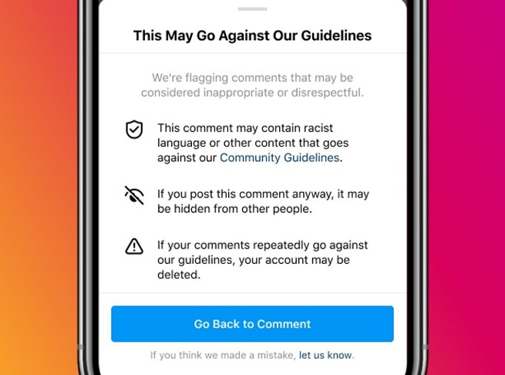

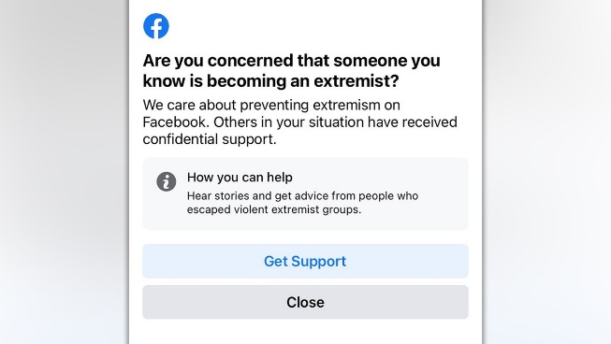
Existing systems
Meta (Facebook) social media platforms’ content filtering system

Slide 10
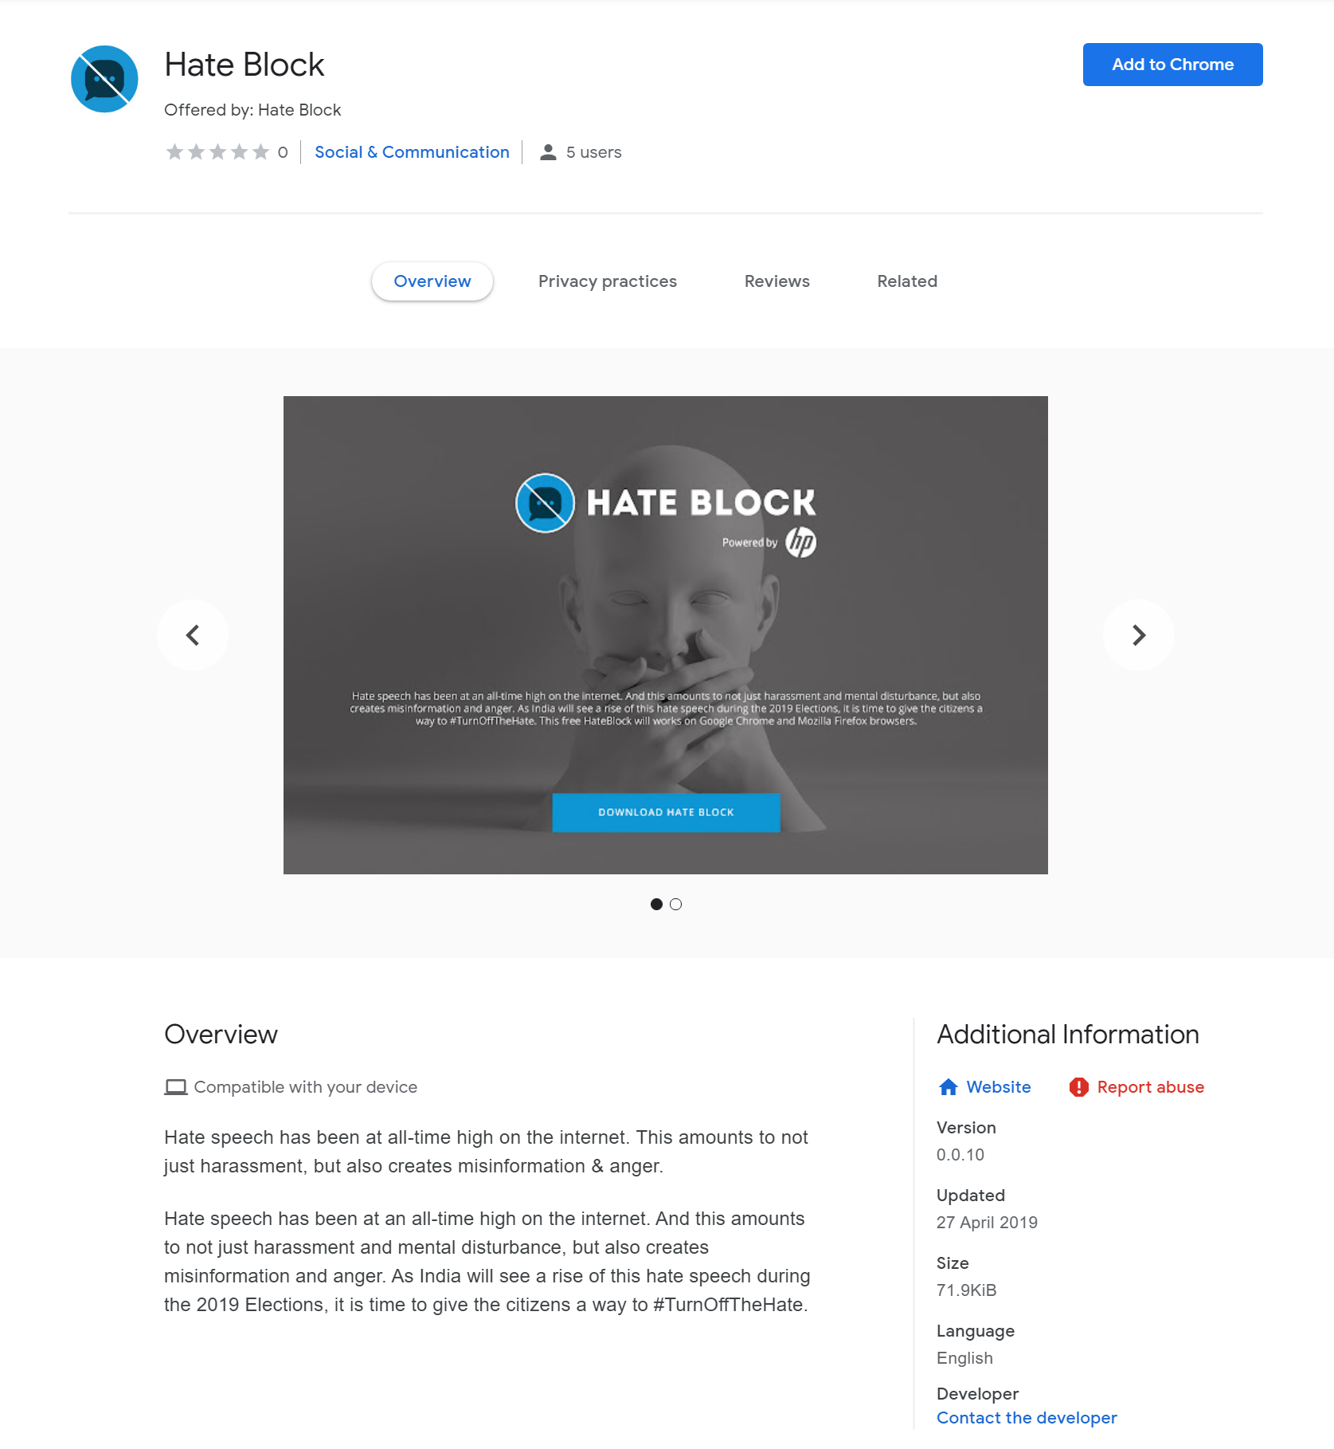
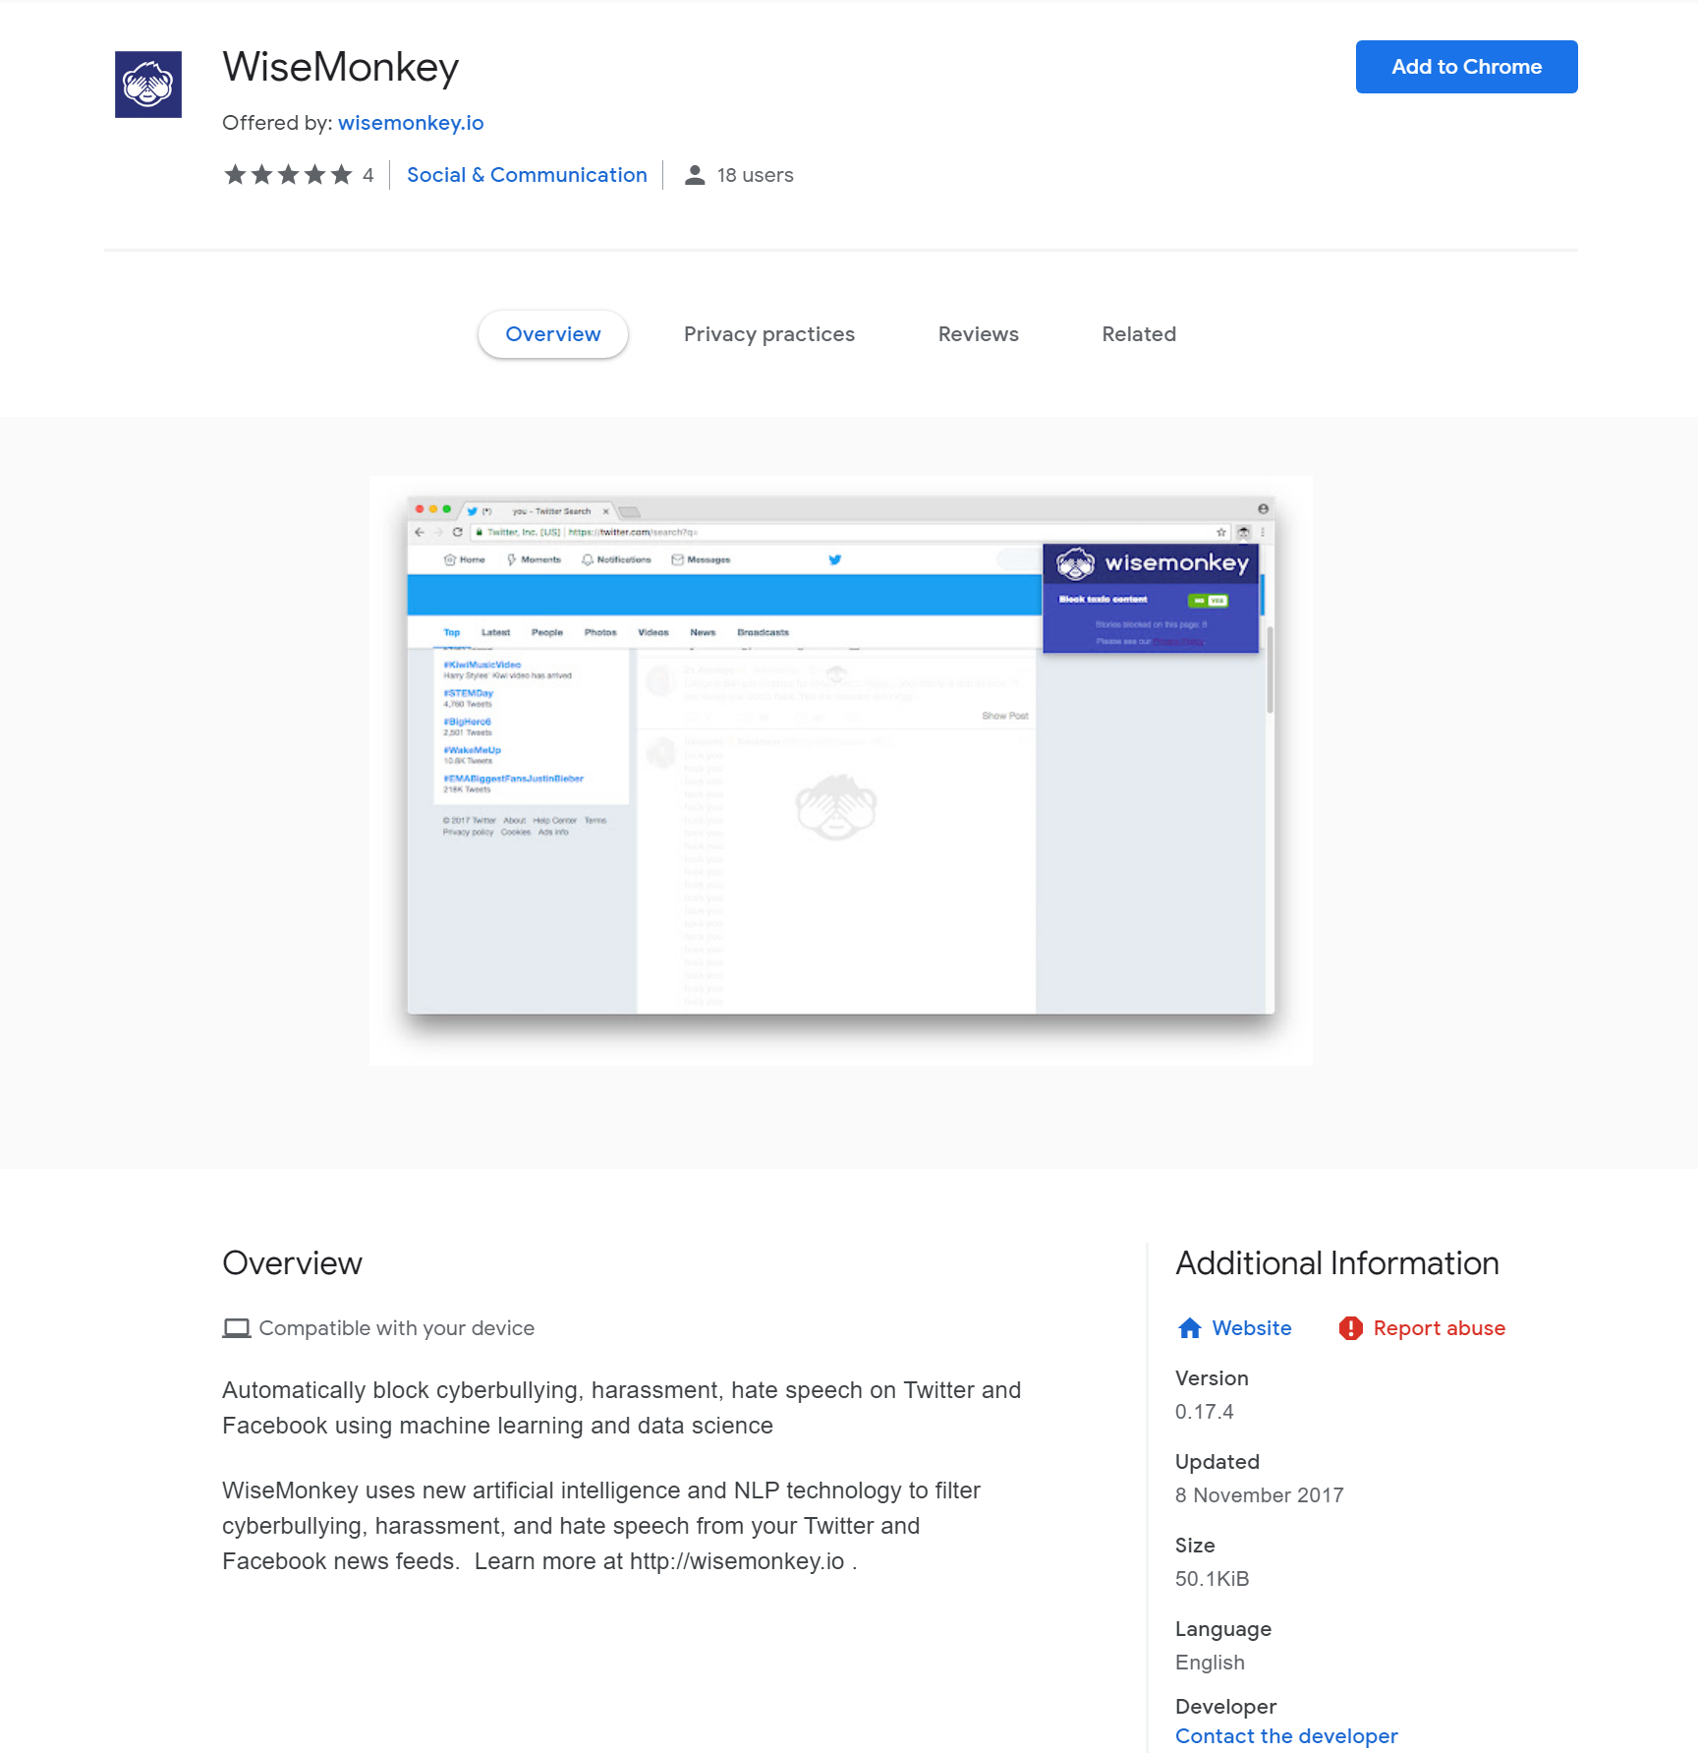
Existing systems
Similar Chrome web browser extensions

Slide 11
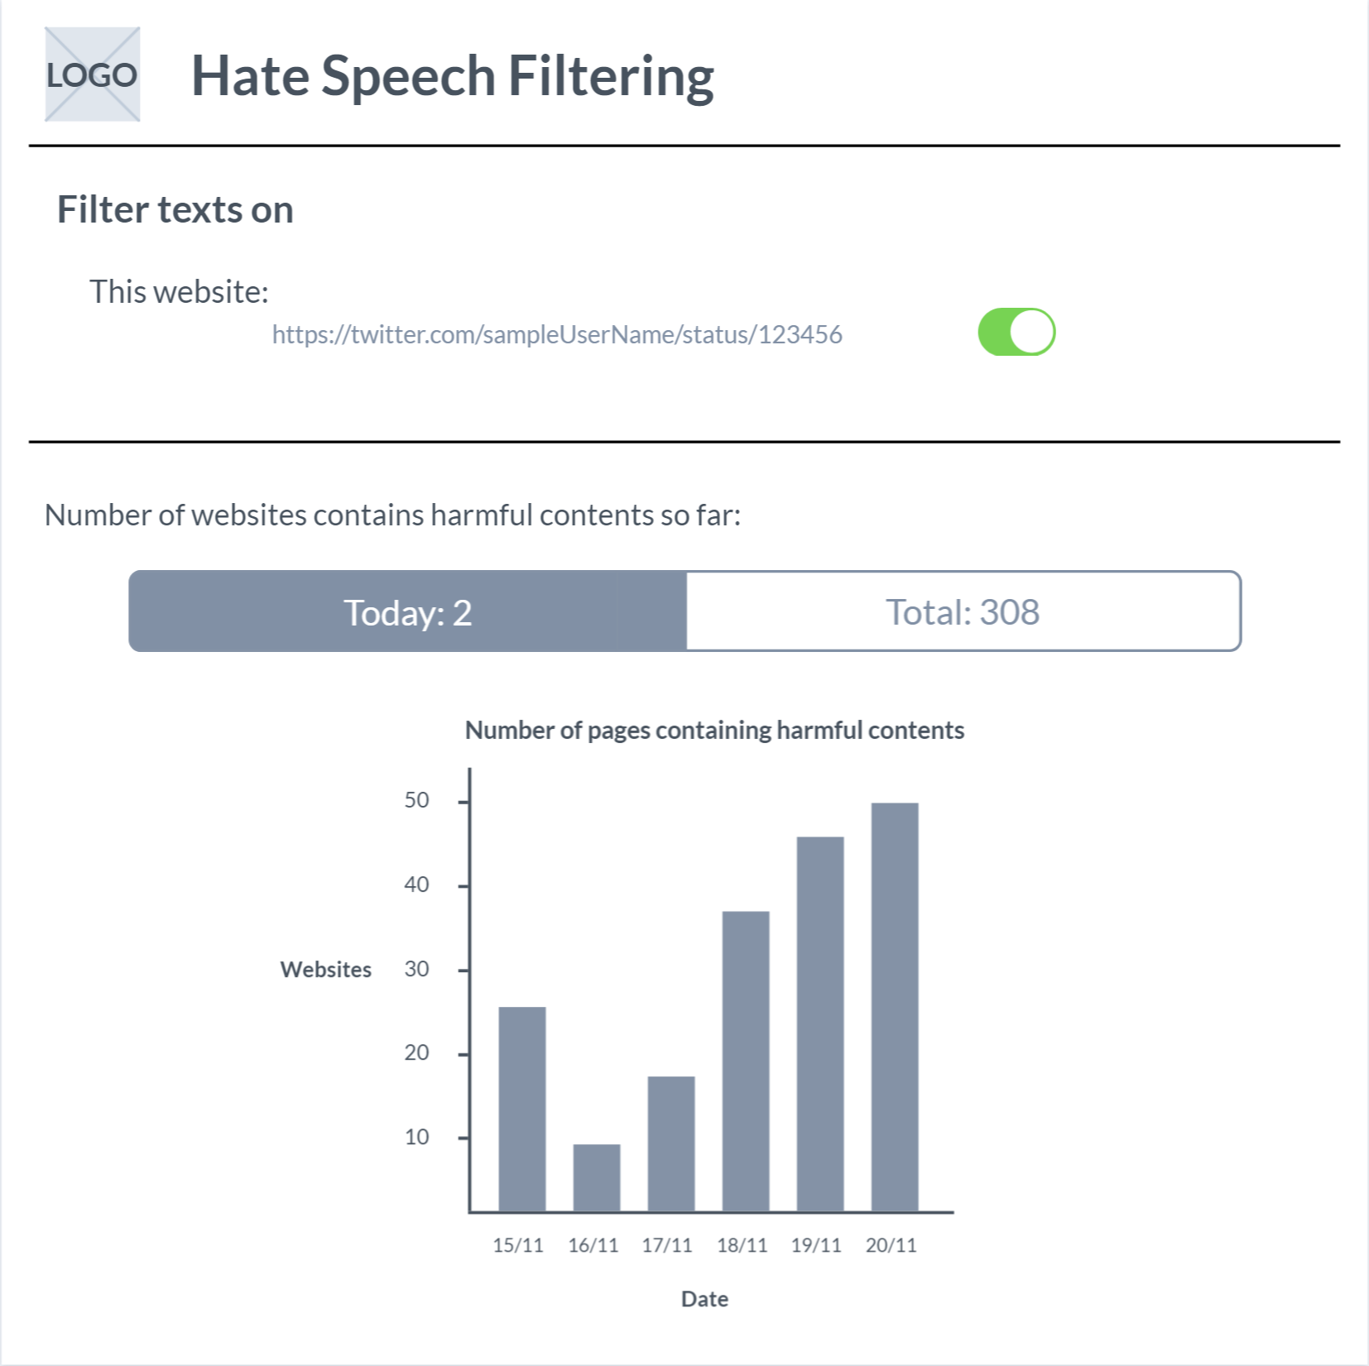
GUI Design
-Extension Interface

Slide 12
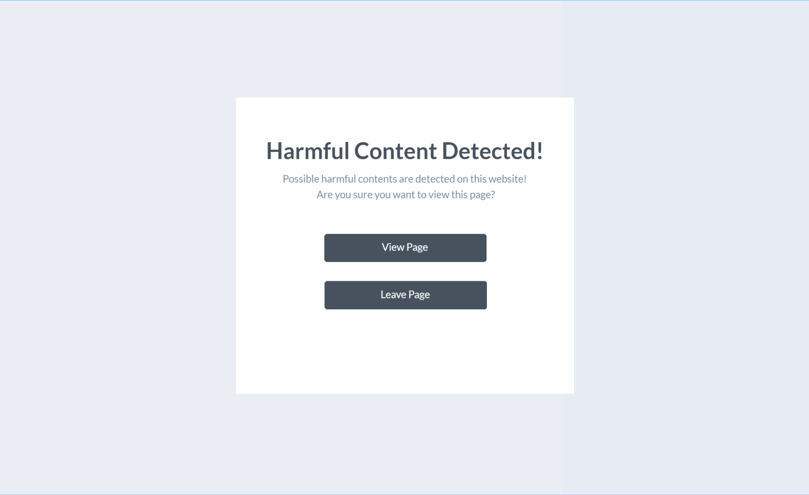
GUI Design
-Warning splash screen

Slide 13
Evaluation
Text scraper
Social media websites
Tweets/posts
Replies/comments
Published documents
Machine Learning algorithm
Training data
Existing results
Web extension
Developer testing
Sample user testing

Slide 14
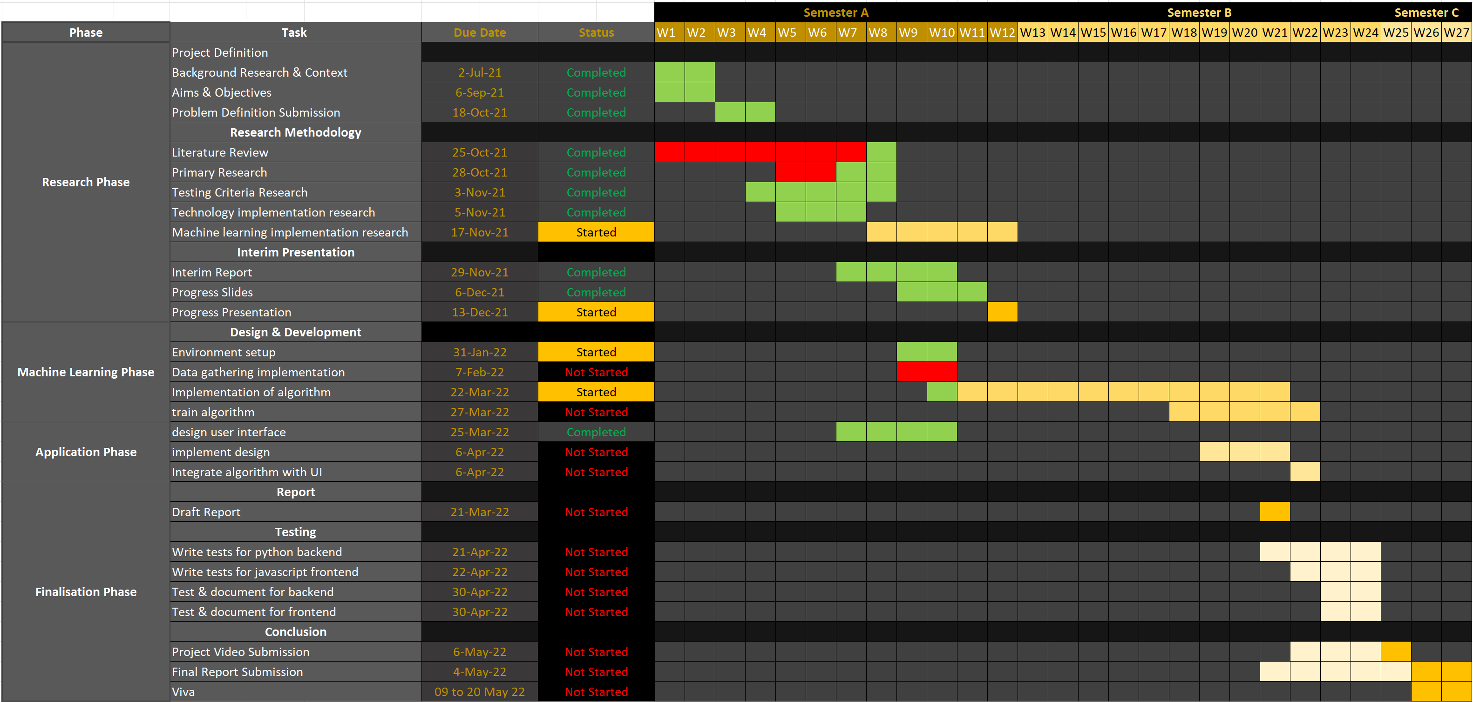
Project Planning

Slide 15
Risk Register
Risk Description | Likelihood rating | Impact rating | Impact | Preventative actions
Poor time management | Medium | High | Affect entire project timeframe, resulting in unfinished final product or a product with less standards | Utilise Gantt chart to track progress regularly, ensure sufficient progress is made on time or ahead of the time
Personal illness and unforeseen events | Low | Medium | Cause delays in final product | Ensure healthy personal schedule and diet, protect mental health
Lack of technical expertise | Medium | High | Cause delays in final product and lower standards in final product | Ensure regular contact with advisor, seek help from experienced peers if necessary
Loss of code/progress | Low | High | Loss of large portions of work if forgot to save progress/computer problems | Use cloud services such as GitHub and OneDrive for code backups
Project development becomes too large to finish before deadline | Low | Medium | Project overextends to unnecessary territories causing loss focus on main functionalities | Stick with original plan for project, minor changes can be done by myself, consult experienced peers and advisor for any major changes to project

Slide 16

References
Brooks, R., 2021. The Origins of Racism. [online] The Conversation. Available at: <https://theconversation.com/the-origins-of-racism-8321> [Accessed 26 November 2021].
Perrigo, B., 2021. Twitter Offers Transparency on Racist Abuse, But Few Solutions. [online] Time. Available at: <https://time.com/6089289/twitter-racist-abuse-anonymity/> [Accessed 26 November 2021].
Lewsley, J., (2020). The effects of racism on health and mental health [online]. Medical and health information. Available at: https://www.medicalnewstoday.com/articles/effects-of-racism#adults [Accessed 26 November 2021].
What is python? Executive summary [online]. Python.org. [Viewed 27 November 2021]. Available from: https://www.python.org/doc/essays/blurb/
Python AI: why is python so good for machine learning? [online]. Custom Software Development | Netguru. [Viewed 27 November 2021]. Available from: https://www.netguru.com/blog/python-machine-learning
NLTK : natural language toolkit [online]. (no date). NLTK : Natural Language Toolkit. [Viewed 27 November 2021]. Available from: https://www.nltk.org/
Profanity-filter [online]. (no date). PyPI. [Viewed 27 November 2021]. Available from: https://pypi.org/project/profanity-filter/#deep-analysis
Beautifulsoup4 [online]. PyPI. [Viewed 27 November 2021]. Available from: https://pypi.org/project/beautifulsoup4/
How different are conventional programming and machine learning? - [online]. Tech Blogger. [Viewed 28 November 2021]. Available from: https://contenteratechspace.com/how-different-are-conventional-programming-and-machine-learning/

